Slide 1
Advanced Data Analysis map() & Custom Functions
Emanuele Della Valle
Prof. @ Politecnico di Milano
Founder & Partner @ Quantia Consulting
Marco Balduini
Founder & CEO @ Quantia Consulting
Riccardo Tommasini
Prof. @ University of Tartu

Slide 2
Exploring flux map()

Slide 3
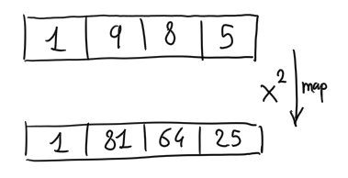
Map()
How does it work?
It applies a function to each element of a collection
e.g., square each number
What’s for?
Combine data
Derive data
Enrich data
Clean data
…
Turn data into information!

Slide 4
Map() in flux
:o
The map() function applies a function to each record in the input tables
The modified records are assigned to new tables based on the group key of the input table

Slide 5
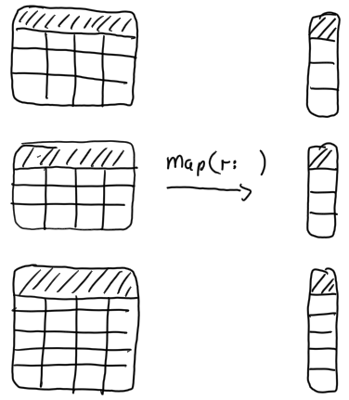
Combine/derive data with map()

Slide 6
_time | _m | _field | _value
10:45 | obs | humidity | 10
11:45 | obs | humidity | 30
GroupKey[obs, humidity]
hour
10
11
_time | _m | _field | _value
11:00 | obs | humidity | 20
11:30 | obs | humidity | 25
GroupKey[obs, humidity]
map(fn: (r) => ({ hour: date.hour(t: r._time) }))
hour
11
11
_time | _m | _field | _value
10:35 | obs | temp | 100
GroupKey[obs, temp]
hour
10
_time | _m | _field | _value
11:15 | obs | temp | 200
11:50 | obs | temp | 300
GroupKey[obs, temp]
hour
11
11

Slide 7
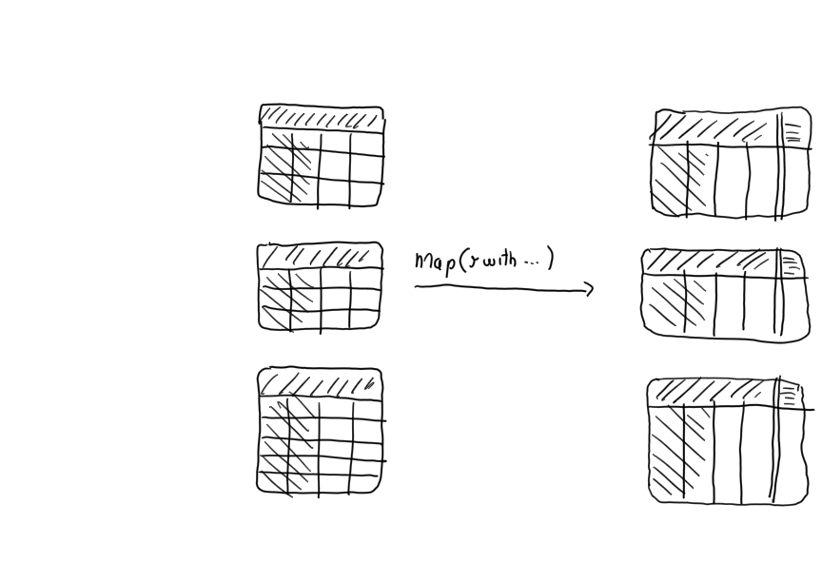
Enrich data using map(r with … )

Slide 8
_time | _m | _field | _value
10:45 | obs | humidity | 10
11:45 | obs | humidity | 30
GroupKey[obs, humidity]
_time | _m | _field | _value | hour
10:45 | obs | humidity | 10 | 10
11:45 | obs | humidity | 30 | 11
GroupKey[cpu, humidity]
_time | _m | _field | _value
11:00 | obs | humidity | 20
11:30 | obs | humidity | 25
GroupKey[obs, humidity]
map(fn: (r) => ({ r with hour: date.hour(t: r._time) }))
_time | _m | _field | _value | hour
11:00 | obs | humidity | 20 | 11
11:30 | obs | humidity | 25 | 11
GroupKey[cpu, humidity]
_time | _m | _field | _value
10:35 | obs | temp | 100
GroupKey[obs, temp]
_time | _m | _field | _value | hour
10:35 | obs | temp | 100 | 10
GroupKey[cpu, temp]
_time | _m | _field | _value
11:15 | obs | temp | 200
11:50 | obs | temp | 300
GroupKey[obs, temp]
_time | _m | _field | _value | hour
11:15 | obs | temp | 200 | 11
11:50 | obs | temp | 300 | 11
GroupKey[cpu, temp]

Slide 9
Clean data using map(r with … )

Slide 10
_time | _m | _field | _value
10:45 | obs | humidity | 10
11:45 | obs | humidity | 30
GroupKey[obs, humidity]
_time | _m | _field | _value
10:45 | cpu | system | 0.1
11:45 | cpu | system | 0.3
GroupKey[cpu, system]
_time | _m | _field | _value
11:00 | obs | humidity | 20
11:30 | obs | humidity | 25
GroupKey[obs, humidity]
map(fn: (r) => ({ r with _value : r._value/100 }))
_time | _m | _field | _value
11:00 | cpu | system | 0.2
11:30 | cpu | system | 0.25
GroupKey[cpu, system]
_time | _m | _field | _value
10:35 | obs | temp | 100
GroupKey[obs, temp]
_time | _m | _field | _value
10:35 | cpu | idle | 1
GroupKey[cpu, idle]
_time | _m | _field | _value
11:15 | obs | temp | 200
11:50 | obs | temp | 300
GroupKey[obs, temp]
_time | _m | _field | _value
11:15 | cpu | idle | 2
11:50 | cpu | idle | 3
GroupKey[cpu,, idle]

Slide 11
Exploring Flux Custom Functions

Slide 12
Recall: What Is Flux?
Flux is a functional data scripting and query language
Written to be:
Useable: easy to learn
Readable: developers read more code than we write
Composable: developers can build onto the language
Testable: queries are code
Contributable: open source contributions matter

Slide 13
Defining and using a custom function
Syntax
<<function name>> = (<<variable>>*) => <<implementation>>
Example
squared = (x) => x*x
from(bucket:"foo")
|> range(start: -1h)
|> filter(fn: (r) => r._measurement == "samples")
|> map(fn: (r) => ({ _value: squared(x: r._value)}))
|> filter(fn: (r) => r._value > 23.2)

Slide 14
Defining a custom pipe forwardable function
Syntax
<<function name>> = (<<table>>=<-, <<variable>>*) => <<table>> |> << implementation >>
Example
allSquared = (tables=<-) =>
tables |> map(fn: (r) => squared(r._value))
from(bucket:"foo")
|> range(start: -1h)
|> filter(fn: (r) => r._measurement == "samples")
|> allSquared()
|> filter(fn: (r) => r._value > 23.2)

Slide 15

Let’s get dirty!
7

Slide 16
Continuous Linear Pizza Oven
Learning goals:
Map functions
Custom functions
s2
s1

Slide 17
Task
Correct the temperature observations of the cooking base area by by subtracting a delta of 5°C to each value
Use an inline map
Create a custom function to be used in the inline map
Create a custom pipe forwardable function that contains a map

Slide 18
Quiz
True or false
in a functional programming language, map() applies a function to each element of a collection – ?
in Flux, map() always adds a column to each table – ?
map() using the with clause can add a column to each table – ?
you can pass a custom functions only to a map() – ?
in a pipe-forwardable custom function with a parameter (t=<-), t represents input tables that the function applies to – ?

Slide 19
Quiz answers
True or false
in a functional programming language, map() applies a function to each element of a collection – T
in Flux, map() always adds a column to each table – F
map() using the with clause can add a column to each table – T
you can pass a custom functions only to a map() – F
in a pipe-forwardable custom function with a parameter (t=<-), t represents input tables that the function applies to – T

Slide 20
Advanced Data Analysis map() & Custom Functions
Emanuele Della Valle Prof. @ Politecnico di Milano & Partner @ Quantia Consulting
Marco Balduini Founder & CEO @ Quantia Consulting
Riccardo Tommasini Prof. @ University of Tartu

